Slide 1

A Primer on Using Generative AI in Medical Education
Presentation Slides:
Christopher Runyon
Albert Einstein School of Medicine
Davidoff Day
April 7, 2025
(both presentations available)

Slide 2
Disclaimer
The information presented in this document/presentation is solely for informational purposes and does not necessarily reflect the official stance or views of NBME. The opinions expressed herein are those of the authors/presenters and may not represent the views or policies of NBME. While every effort has been made to ensure the accuracy and reliability of the information provided, NBME makes no representations or warranties of any kind, express or implied, about the completeness, accuracy, reliability, suitability, or availability with respect to the content contained herein. Any reliance you place on such information is therefore strictly at your own risk.

Slide 3
Learning Objectives
Explain the fundamental architecture of Generative AI models
Describe the advantages and limitations of using Gen AI in various applications within medical education
Design and evaluate effective prompts that leverage Gen AI strengths for creating educational content and assessments
Demonstrate the ability to integrate Gen AI into existing instructional strategies to improve the quality and efficiency of medical education

Slide 4
Why learn technical aspects of LLMs?
LLMs vs Microwaves
Helps with understanding why prompt engineering is important and how you may need to adjust your prompts.
Helpful for independent problem solving
Microwaves | LLMs
Been around for decades | Recently developed
Technology (largely) unchanged | Technology is constantly evolving
Best practices are well-known | Best practices still being developed

Slide 5
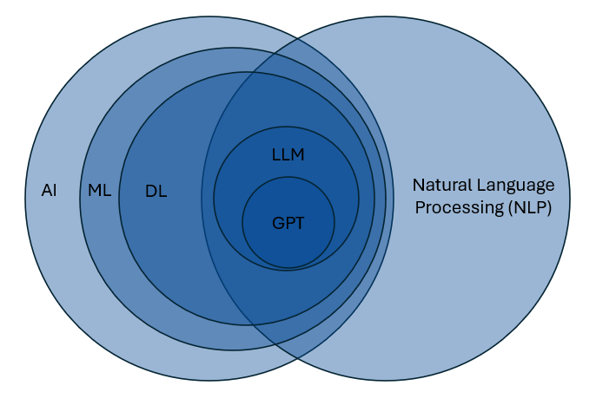
What are Gen AI models?
AI = Artificial Intelligence
ML = Machine Learning
DL = Deep Learning
LLM = Large Language Models
GPT = Generative Pretrained
Transformers

Slide 6
Variations in Generative AI Models
OpenAI’s ChatGPT (several models)
Anthropic’s Claude
Google’s Gemini
DeepSeek
Meta’s Llama (Llama 4 models just released!)
…
Many freely-available models available through huggingface.co

Slide 7

How LLMs Make Sense of Language
Underlying principle: distributional semantics / co-occurrence
Words that occur in the same contexts tend to have similar meanings. (Harris, 1954)
“We found a little, hairy wampimuk sleeping behind the tree.”
Not deterministic; variation is part of its beauty
A very, very fancy text calculators
Harris ZS. Distributional structure. Word. 1954;10(2-3):146-162.
Wampimuk sentence from: https://aclanthology.org/P14-1132
Image generated with ChatGPT 4o

Slide 8
In less than 15 words, please describe why pizza is so good
Model | ChatGPT 4o
Temperature | 1 (default)
Pizza combines savory, cheesy, and versatile toppings on a delicious, soft, or crispy crust.
Pizza combines savory cheese, flavorful toppings, and a crispy crust for a satisfyingly delicious experience.
Pizza's delicious due to its savory combination of cheese, sauce, and various toppings.
Pizza combines savory flavors, melty cheese, and a satisfying crust in every bite. Irresistibly delicious!
Pizza's delicious due to its perfect blend of cheese, sauce, and various toppings.

Slide 9


Model parameters
Temperature
“What sampling temperature to use, between 0 and 2. Higher values … will make the output more random, while lower values … will make it more focused and deterministic.”
Sides of a die that are possible
Does not guarantee that result will be exactly reproduced.
top_p (nucleus sampling)
“An alternative to sampling with temperature, called nucleus sampling, where the model considers the results of the tokens with top_p probability mass. So 0.1 means only the tokens comprising the top 10% probability mass are considered.”
Fairness of the die / limiting the sides that are possible
“It is recommended to alter [one or the other] but not both.”
[All text from the OpenAI API reference manual]

Slide 10
Variability in LLM Responses
Model | ChatGPT 4o
n replications | 100
Temperature | 0
Replicated pizza prompt
5 different responses:
(89) – “Delicious, versatile, customizable, and universally loved comfort food with endless topping possibilities."
(7) – “Pizza combines diverse flavors and textures, customizable toppings, and universal appeal in one dish.”
(1) – “Delicious, versatile, and customizable; perfect for any occasion and loved by almost everyone.”
(1) – “Delicious, versatile, and customizable; pizza satisfies cravings with endless topping combinations.”
(1) – “Delicious, versatile, customizable, satisfying, and perfect for sharing; pizza pleases almost everyone.”
(1) – “Delicious, versatile, customizable, satisfying, and universally loved comfort food with endless topping possibilities.”

Slide 11
Variability in LLM Responses
Higher temperatures
(more creative)
Lower temperatures
(more consistent)
Variation in content generation
Clinical case development
Simulating patient responses
Generating varied feedback examples
Scoring assessment tasks
Creating uniform materials
Standardizing OSCE patient cases
Summarizing tasks
Ensuring consistent feedback

Slide 12
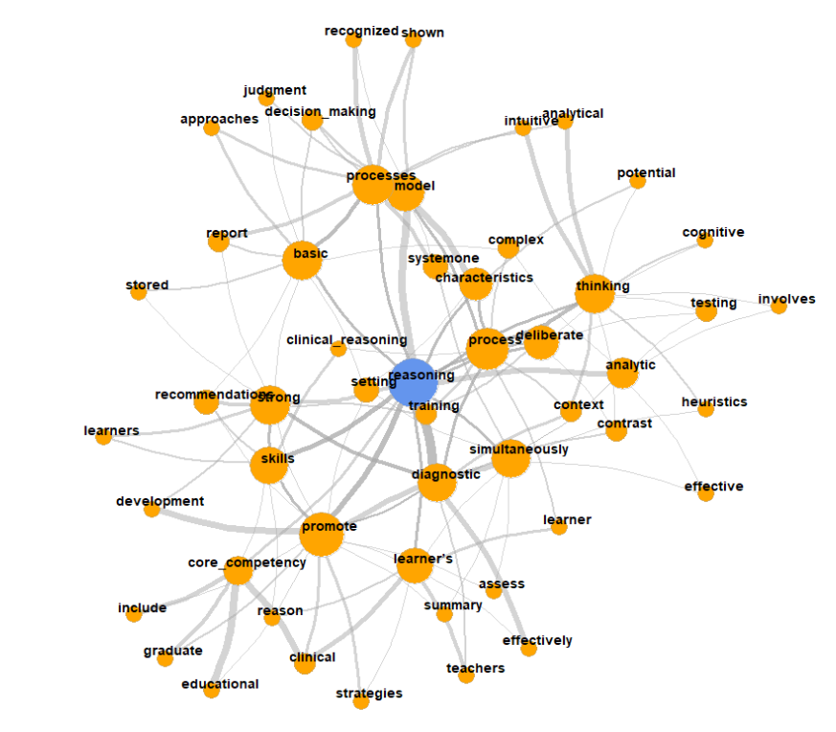
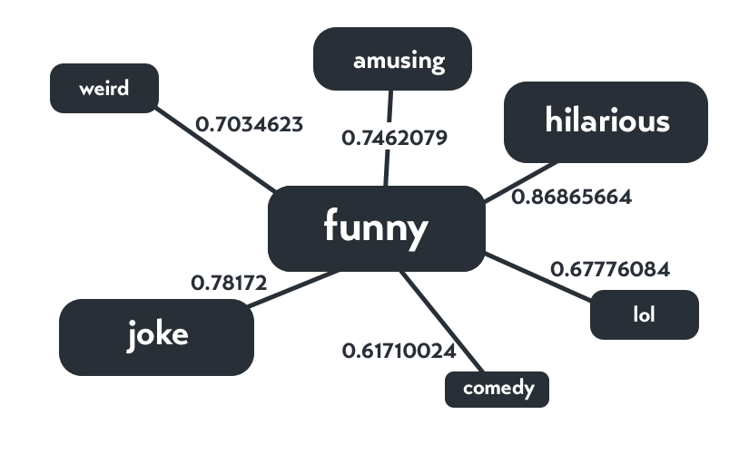
Llama: 8 – 405 Billion Parameters
(varies based on model)
DeepSeek R1: 671 Billion

Slide 13
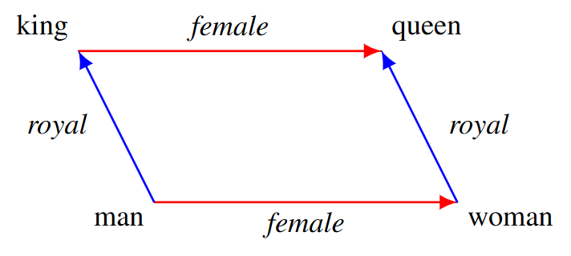
Embeddings / “Concepts”
Word embeddings represent words as vectors in a multi-dimensional space, encoding their semantic meaning and relationships.
King – Man + Woman ≈ Queen
Image from : [https://arxiv.org/abs/1810.04882]

Slide 14
Attention
The attention mechanism in a Gen AI models helps the model focus on the most relevant words in the sequence (i.e., the prompt).
“We found a little, hairy wampimuk sleeping behind the tree.”
Words like “little”, “hairy”, and “sleeping” provide important information about the wampimuk.
Other words less so: “we”, “found”, “behind”, “tree”
Others still even less: “a” “the”
Wampimuk sentence from: https://aclanthology.org/P14-1132

Slide 15
Attention
LLMs, like humans, have limited attention
Prompts that give LLMs many tasks at once may result in suboptimal performance.
Difficult to identify what are the most important parts of the task.
May do some tasks well and others poorly; or all only moderately well.
Some newer models (“reasoning models”) are trying to explicitly address this limitation.

Slide 16
Attention
The attention can also be impacted by the length of the conversation you have (when using the chatbot versions of Gen AI Models)
May start the conversation well, but “forget” important parts later
Can be a problem when building a Gen AI model to act as a standardized patient (or similar role)
Alternatively, the Gen AI model can also fixate (over-attend) to details that you didn’t intend to be important and unnecessarily carry those forward in the conversation
Can be mitigated with subsequent prompts – provide it with feedback!

Slide 17
Prompt Engineering
There are ways to interact with GPTs that can result in more useful responses
Provide more context for what you would like the GPT to output
Help activate more relevant connections in the network
We’re going to focus on two general strategies for prompting
Prompt formulas
Prompt refinement
Prompt chaining / chain-of-thought prompting

Slide 18
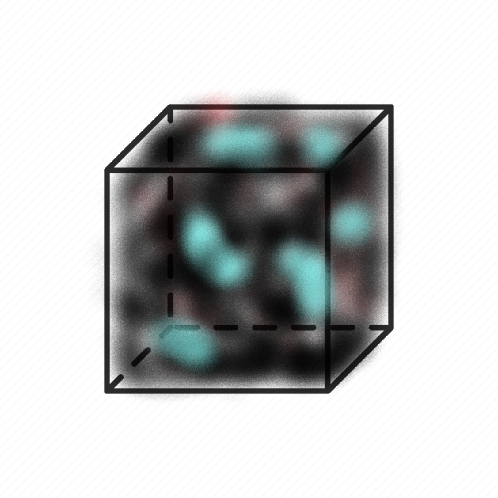
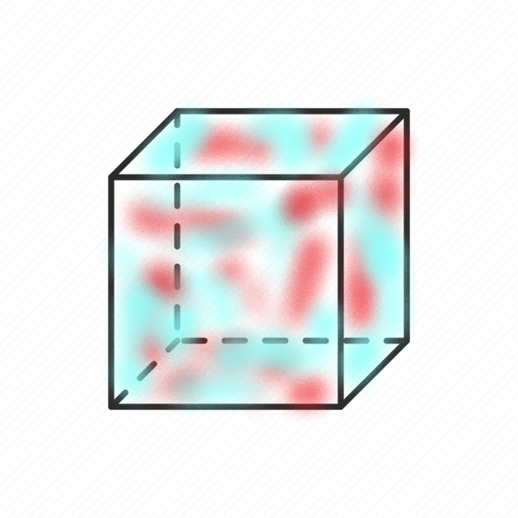


Pre-trained parameters
Prompt
Updated parameters
Output

Slide 19
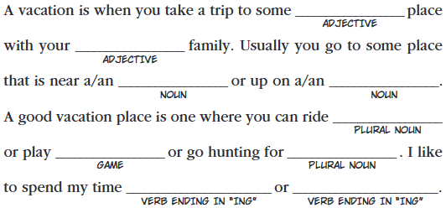
“Degrees of Freedom” in LLM Prompts
When prompting an LLM, any detail you don’t explicitly specify will be inferred by the model.
Good = want general creative help
Bad = have a specific assessment point in mind
https://madlibs.com/wp-content/uploads/2024/06/VacationFun_ML_2009_pg15.pdf

Slide 20
“Degrees of Freedom” in LLM Prompts
Example: “Develop an assessment question about an illness that could be caused by two different organ systems.”
What’s missing here?

Slide 21
“Develop an assessment question about an illness that could be caused by two different organ systems.”
Purpose of assessment
Level of learner
Difficulty
What makes it difficult?
Length / format of question
Multiple-choice?
Vignette-based?
Chart-based?
Written response?
Patient Characteristics
Age, Gender, Sex
HPI
PMH
The organ systems
Leading diagnosis? (“Truth”)
Specific illnesses
Method of differentiation
Dx test?
Other?

Slide 22
“Degrees of Freedom” in LLM Prompts
When prompting an LLM, any detail you don’t explicitly specify will be inferred by the model.
Example: “Develop an assessment question about an illness that could be caused by two different organ systems.”
Filling in these unknowns (“degrees of freedom”) when providing instructions to the LLM will increase the likelihood that the result will be closer to what you want.

Slide 23
Prompt formulas
Structured guidelines or templates used to generate responses from language models like GPT-4o
Help shape the context, style, and content of the output

Slide 24
ROLE
TASK
GOAL
[I am in my mid 40s and I am becoming more interested in film.] [I would like to learn more about the intersection of romance and sci-fi genres.] [Please suggest 10 popular movies in romance/sci-fi genre and provide details on why these movies are thought to be important or interesting.]
ROLE
TASK
GOAL
[I am organizing a conference], and I would like help [developing icebreaker interactive sessions] for conference participants. [Please suggest 3 icebreaker interactive activities, and provide details such as timing, materials needed, and activity objectives. Suggest a 30-minute, 60-minute, and 90-minute activity.]

Slide 25
CONTEXT
ACTION
RESULT
EXAMPLE
[I work in medical education], and I would like help [developing sample patient charts to accompany test questions about ___.]
[Each patient chart should have the same structure and contain similar content but should differ on what the final diagnosis or best patient management should be. ]
[After I submit this prompt, I will then provide an example format that the patient chart should follow.]

Slide 26
Prompt Formulas
Providing an Example Output helps do 2 things:
It provides a replicable example for the GPT to emulate.
No guarantee the GPT will precisely replicate the output, but, if not, will be close.
The content of the example acts as additional instructions.
The GPT will evaluate the relationship of the content to the structure of the output to infer more information about your prompt.

Slide 27
Structuring Prompts
In addition to using prompt formulas (or other prompting strategies), strategically using punctuation—such as braces or brackets—can highlight key parts of your prompt and guide the LLM’s focus.
Role: [You are a medical educator specializing in internal medicine.]
Task: [Review the following clinical vignette and create a single best answer multiple-choice question with four options. Clearly indicate the correct answer.]
Vignette: [A 45-year-old man comes to the emergency department with sudden onset of shortness of breath and pleuritic chest pain. He has a history of long-haul flights and recent orthopedic surgery. On examination, he is tachycardic and his oxygen saturation is 89% on room air. A chest CT scan shows a filling defect in the right pulmonary artery.]
Additional Instructions: [Ensure the correct answer focuses on the most likely diagnosis based on the vignette.]

Slide 28
Prompt Refinement w LLMs
Prompt the LLM to provide feedback on the structure of the prompt
Structure
Areas in need of more detail
Using a prompt formula:
“I am a [ROLE] and I am building a prompt to [TASK]. The goal of the prompt is to [GOAL]. Review the following prompt I have developed and provide suggestions to improve (1) the prompt structure and (2) instructions where more detail would be beneficial so the prompt will more effectively help me achieve my goal.”

Slide 29
Prompt Refinement w LLMs
I am a [ROLE], creating a prompt to [TASK]. The goal of this prompt is to [GOAL].
What I Need:
Review the prompt I have drafted (below).
Suggest how to enhance its structure and clarity.
Explain if there are areas where more specific instructions are needed to ensure the final output meets my goal.
Provide a brief rationale for each improvement and, if possible, a sample rewrite.
Draft Prompt to Review: [Paste Your Draft Prompt Here]
Important Details:
Format your suggestions in bullet points.
Keep the total word count under 200 words.
The audience for the final output is [specific audience].”

Slide 30
Chain Prompting
Chain-of-Thought Prompting: Encourages ChatGPT to articulate its reasoning process in steps
GPT breaks a complex task into smaller tasks
Method improved by providing an example
“Think step-by-step”
Prompt Chaining: Sequentially linking multiple prompts where each step's output feeds into the next
- User breaks down a complex task into smaller tasks

Slide 31
Chain-of-Thought Prompting
Best Use Cases
Less Effective Use Cases
Complex reasoning tasks
Explaining complex concepts
Creative tasks
Can provide a “thought process” leading to the result
Inferences & Explanations
Can include intermediate steps like interpretations and how it reached a conclusion
Procedural or Step-by-Step Tasks
Unnecessary elaboration, confusing the model
Simple Prompts
Adds fluff w/o improving accuracy
Strict Formatting Requirements
Can make responses messy

Slide 32
Prompt Chaining
Helpful to reduce the “cognitive load” of the LLM; better control of the model attention.
Better control over what the model does at each step.
More detailed instructions on each step
More transparency / error isolation
Have intermediate records
Can catch early errors that propagate forward

Slide 33
Prompt Chaining
Strengths
Weaknesses
Modular approach
Reduced complexity of instructions
Error isolation
Clear, structed workflow
Requires more planning
User errors
Information must manually be passed to each subsequent step
More time and resource intensive
More complex than a single-prompt process

Slide 34
Student
Post-Encounter Note
Analytic
Scoring Rubric
Specific Feedback Instructions
Prompt: Synthesize Class Output
Output:
Aggregate
Student Results
Prompt:
Apply Note to Rubric
Output:
Note Scored with Rubric
Prompt:
Make Student Feedback
Output: Student Specific Feedback
Prompt Chaining:
An Example with
OSCE Note Grading
Prompt: Extract Score and Make Report

Slide 35

Applications in Medical Education

Slide 36
Applications in Medical Education
Scoping Review of AI in Medical Education Assessment (2024; BEME Guide)
Supplemental Material – Articles included in the Guide
Admission / Selection
Teaching / Instruction (Simulation)
Assessment (Clinical Skills, MCQ generation, text analysis, prediction, surgical skills)
Clinical Reasoning
Automation of case /procedural logs
Knowledge / Attributes of AI
Performance of LLMs on Medical Examinations
+ Perspectives!

Slide 37
Applications in Medical Education
Artificial Intelligence in Health Professions Education assessment (AMEE Guide No 178) – 2025
Issue, Theory, Potential, Examples / Best Practices, Limitations
Theories and Frameworks
Human Responses
Personalised and flexible summative assessment
Assessment standardization
Personalized and flexible formative assessment
Take-home essay
Other Assessment Types
AI as Tutor
AI as Learner
Competency-based Assessment
Difficult areas and ethical issues

Slide 38
LLM Applications in Assessment
MCQ / Item Generation
- Can use a structured prompt to help generate new items for a specific parts of the curriculum.
- “You are a medical educator that is an expert in [topic]. You are developing an examination to assess student’s knowledge of [more specific topic]. Your are generating a USMLE-style item for this purpose. The item should be appropriate for [level of learner].”
- Even better: “I will post an example item; please mimic this style while adhering to USMLE guidelines.”

Slide 39
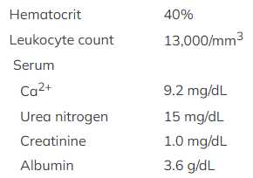
LLM Applications in Assessment
From the Step 2 CK sample questions:
A hospitalized 57-year-old man has had severe progressive pain in his left knee since awakening 2 hours ago. He was admitted to the hospital 2 days ago for an acute myocardial infarction. Cardiac catheterization showed occlusion of the left anterior descending artery, and he underwent placement of a stent. Current medications include aspirin, metoprolol, lisinopril, simvastatin, clopidogrel, and heparin. Vital signs are within normal limits. Examination of the knee shows a large effusion. The knee is hot to touch and erythematous. He holds the knee in 30 degrees of flexion; the pain is exacerbated with further flexion or extension. Laboratory studies show:
An x-ray of the left knee shows calcification of the synovium. Which of the following is the most likely diagnosis?
Deep venous thrombosis
Gonorrhea
Gout
Hemarthrosis
Pseudogout
Septic Arthritis

Slide 40
LLM Applications in Assessment
“I would like for you to generate a new MCQ item in the same format with the same response options, and I want you to change the case content to make one of the incorrection options the correct answer.”
“Change the item content so the correct answer is now [pick other option]”

Slide 41
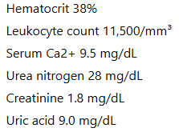
LLM Applications in Assessment
A 60-year-old man comes to the emergency department with severe pain and swelling in his right big toe that began abruptly overnight. He has a history of hypertension and chronic kidney disease. Medications include lisinopril and hydrochlorothiazide. He drinks two to three beers nightly. Physical examination reveals a swollen, erythematous right first metatarsophalangeal joint that is warm to the touch. He has marked tenderness and pain with even light touch or passive motion. Laboratory studies show:
An x-ray of the foot reveals no bony erosions. Which of the following is the most likely diagnosis?
Deep venous thrombosis
Gonorrhea
Gout
Hemarthrosis
Pseudogout
Septic Arthritis

Slide 42
LLM Applications in Assessment
“I would like for you to generate a follow-up MCQ item about the best step in management for this condition.”
The 60-year-old man described above is diagnosed with acute gout affecting the right first metatarsophalangeal joint. Which of the following is the most appropriate next step in management?
Allopurinol
Colchicine
Hydrochlorothiazide dose adjustment
Indomethacin
Intra-articular corticosteroid injection

Slide 43
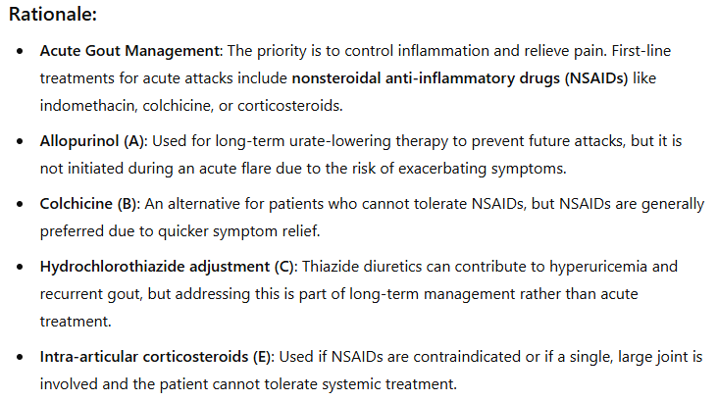
LLM Applications in Assessment
The 60-year-old man described above is diagnosed with acute gout affecting the right first metatarsophalangeal joint. Which of the following is the most appropriate next step in management?
Allopurinol
Colchicine
Hydrochlorothiazide dose adjustment
Indomethacin
Intra-articular corticosteroid injection

Slide 44
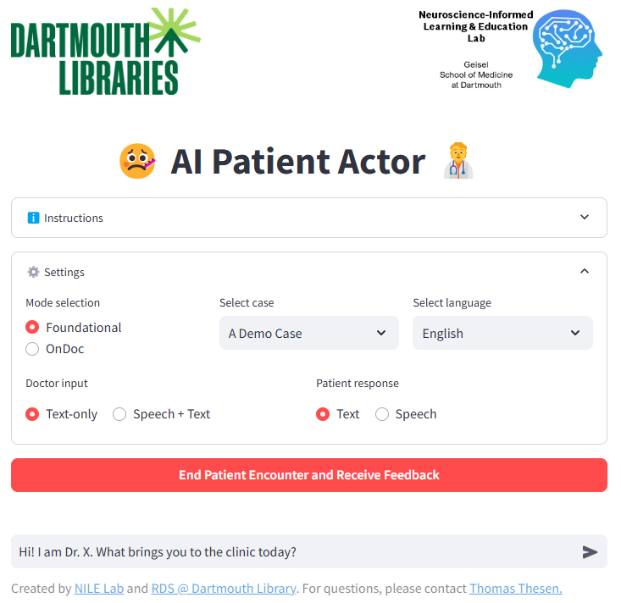
LLM Applications in Assessment
AI Patient Actor from Dartmouth Laboratories

Slide 45
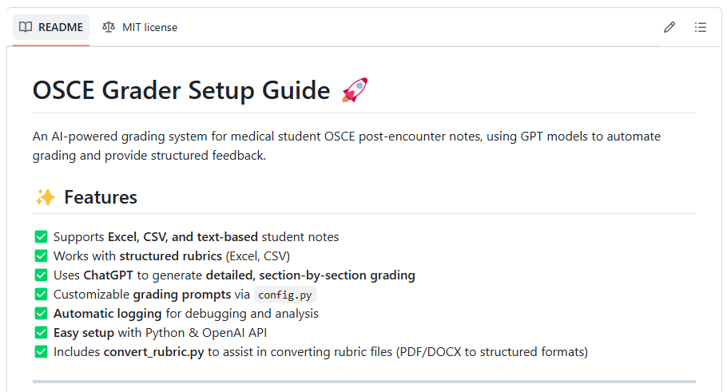

OSCE Grader
https://github.com/christopherjnash/OSCE-Grader

Slide 46
Other interesting use cases
First-pass TA
Built a GPT that is further trained on materials for the course.
Students first ask the GPT their question about the course material.
GPT then either (a) provides the answer with where it can be found in the material or (b) provides where it can be found in the material [I forget]
If not a satisfactory answer, student indicates this and the question is passed on to the instructor
Precision Medical Education (e.g., NYU Grossman)
Custom tailored educational opportunities

Slide 47
Other interesting use cases
Curriculum Design / Instructional alignment
Generate / refine learning objectives
Lesson plan structuring
Develop / refine assessment content aligned with the LOs
Rubric refinement
See how the GPT interprets rubric rules
Clinical Mind AI (Stanford) ; MedSimAI

Slide 48


Slide 49
Chatbot vs. API Usage
Chatbot
API
Easier user interface; requires no programming knowledge
Can provide feedback / continue prompting sessions
Single cost (monthly subscription)
Not able to easily vary model parameters (e.g., Temperature)
Can be laborious for use at scale
Can build into a program so can be used at scale
Easy to manipulate model parameters
Cost per use (e.g. OpenAI)
Requires some programming knowledge
Cannot continue prompting sessions

Slide 50
Use LLMs Responsibly: Data Privacy
Data Privacy and Security
Never submit any personally identifiable information (PII), patient data, or student records to an AI model (including GPTs).
Understand GPT data retention policies – some AI providers may log or store inputs/outputs.
Assume that all interactions with GPTs are not private unless you have checked with the appropriate IT and legal people at your institution

Slide 51
Use LLMs Responsibly: Compliance
AI usage policies vary by region
National
Ensure that all AI use follows all national mandates
State
States may have additional mandates or guidelines around AI use in addition to national regulations
Local institution
Even further, your institution or organization may have specific guidelines around AI use
AAMC has a website specifically dedicated to these matters
Before using AI/GPTs in any operational setting, consult your legal and IT departments.

Slide 52

NBME MICROCREDENTIALING SHORT COURSE
Later this year NBME will begin offering free microcredentialing short courses. Be among the first to enroll in our introductory course:
“A Primer for Using Generative Artificial Intelligence in Medical Education.”
Scan the QR code to stay informed and reserve your spot when registration opens!

Slide 53

Questions? Feedback?
Christopher Runyon
CRunyon@nbme.org
or use this QR Code
Presentation Slides:
(both presentations available)

